Slide 1
Telecom Customer Churn Analysis and Prediction
Chan Chong Wee
23rd March 2024

Slide 2




Content
1 Who?
01 About Me
02 Course Journey
2 Why?
03 Project Overview
04 Problems and Objectives
05 Current State Analysis
3 What?
06 Technology Stack
07 Customer Churn Analysis
08 Customer Churn Prediction
4 How?
09 Project Timeline
10 Project Budget

Slide 3




About Me
Bachelor of Arts (Hons) in Business Management, Teesside University
TripleTen Data Science Program
The Future Talent Data Science Analytics Program
Education Background
Experience
Secondary school mathematics tutor with 10 years of experience
Tuition centre branch supervisor
Career Objective
Analytical and reasoning skills
Passionate about discovering actionable insights from data
Continuous learning and contribute as a valuable team member
Chan Chong Wee

Slide 4




Course Journey
Month 1
Month 2
Month 3
Month 4
Big Data and Data Science
Data Science Methodology
Python Programming
Data Wrangling
Data Visualisation
Exploratory Data Analysis
Machine Learning
Deep Learning
MySQL
Self Resilience
Communication
Career Launchpad Mastery

Slide 5




Project Overview
Scenario
The customers of the company are leaving little by little every month.
What has been found?
More cost-effective to retain the existing customers rather than acquiring new ones.
Action to be taken
Offer promotional codes and special plan options to those who are planning to leave.
Who are the targets?
Conduct customer churn analysis and prediction.

Slide 6


Problems and Objectives
Problems
Objectives
How accurate can customer churn be predicted with a machine learning model?
Develop a machine learning model to predict customer churn with a ROC-AUC score of at least 85%.
What are the common traits or patterns exhibited by customers who have churned.
Identify the characteristics and behaviours that differentiate active customers from those likely to leave.

Slide 7




Current State Analysis
Insufficient Insights
Data Silos
Data
Quality
Data
Security
Why customers left?
Who will be the next one to leave?
Data is dispersed across different departments
Data is inconsistent, inaccurate, and incomplete
Vulnerable to unauthorised access, security breaches and data leaks
Loss of customers and profits
Waste of resources
Difficulty in information sharing
Poor decision-making
Operational inefficiencies
Miss of Insights
Loss of credibility
Customer dissatisfaction

Slide 8





Technology Stack
Data Storage
Relational Database Management System (MySQL)
Exploratory Data Analysis
Python (Pandas, NumPy, Matplotlib, Seaborn)
Version Control
Model Development
Python (Scikit-Learn, XGBoost, LightGBM, CatBoost, Optuna)
Git and GitHub
Model Deployment
Python
Streamlit

Slide 9
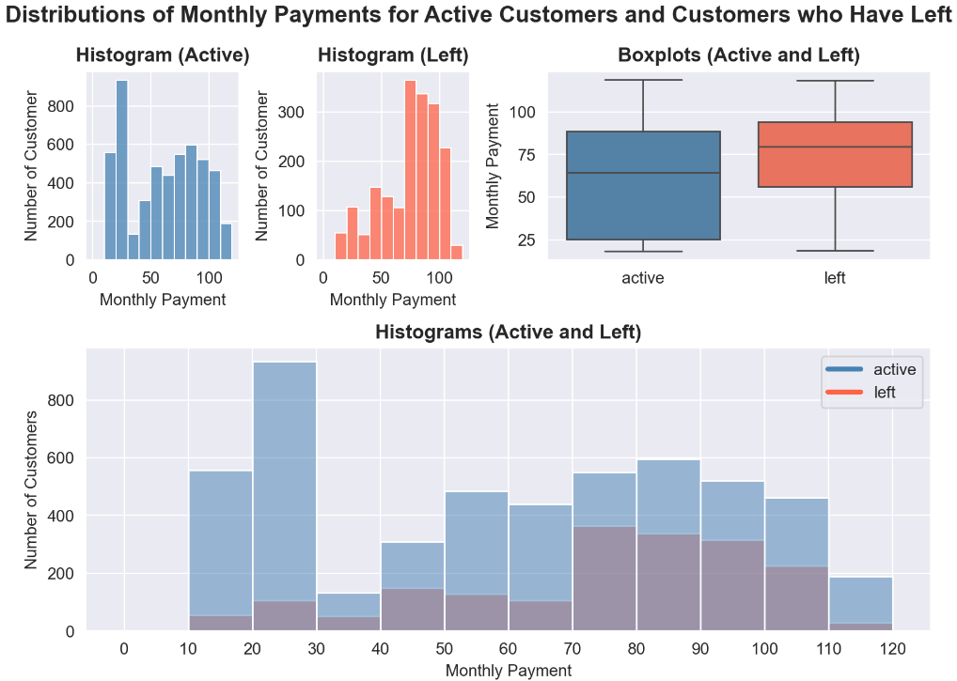
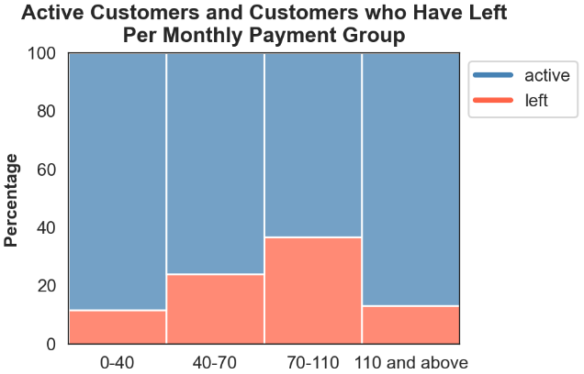
Customer Churn Analysis
The high-paying customers also have high churn rate !!!

Slide 10
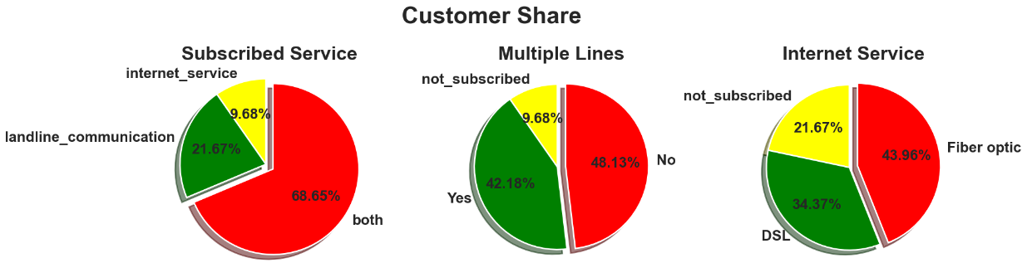
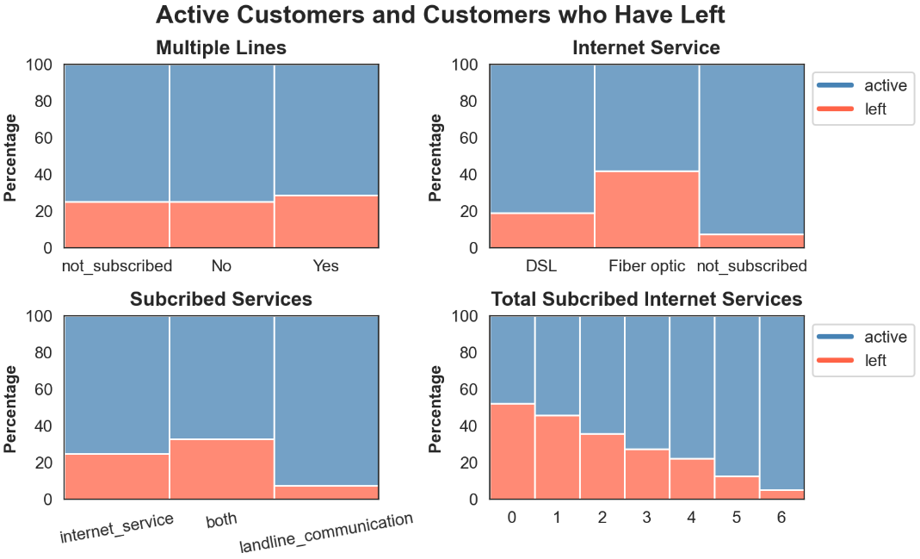
Customer Churn Analysis
About 80% of customers currently use or have used internet service.
Fiber optic is the primary option.
Higher churn rate from internet service users
Especially the fiber optic users
More additional subscribed internet services, less likely the customers will leave

Slide 11
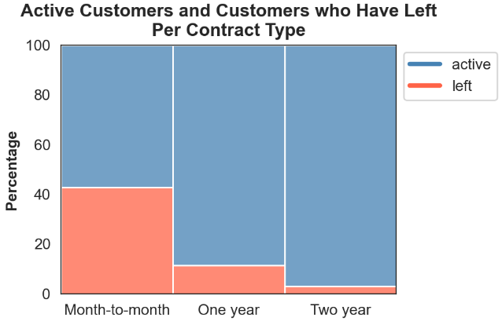
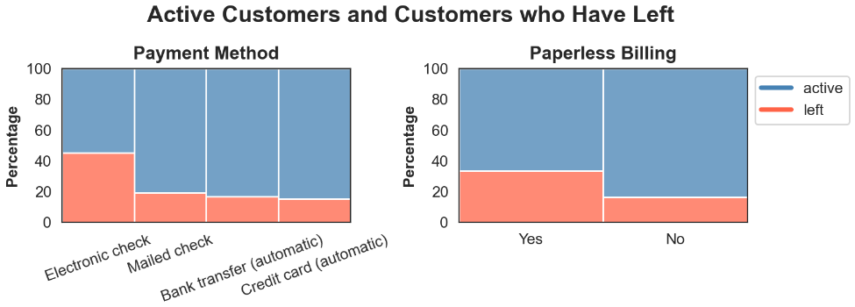
Customer Churn Analysis
The churn rate from the monthly contracts users is at least three times higher than the other groups.
Any issue with the electronic check payment method and paperless billing system?

Slide 12
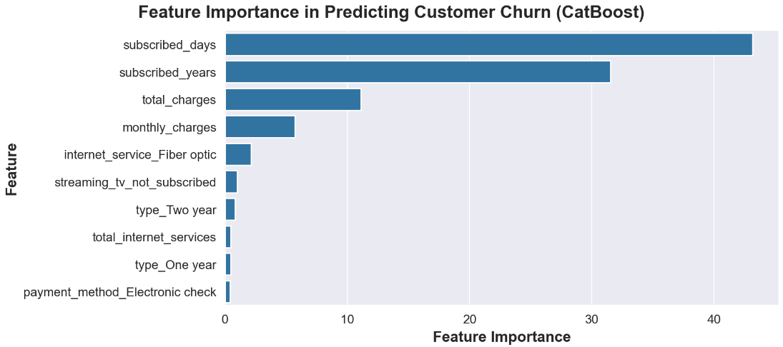
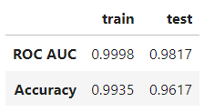
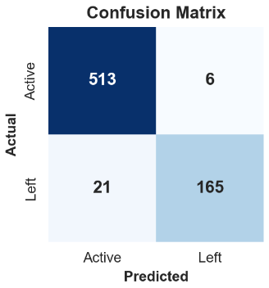
Customer Churn Prediction
Prototype

Slide 13
Project Timeline
Customer Churn
Analysis
Data Requirements
Business Understanding
Analytic Approach
Data Collection
Exploratory Data Analysis
Data Understanding
Data Wrangling
Model Development
Feedback
Model Evaluation
Model Deployment
06/03/2024
22/03/2024
04/03/2024
08/03/2024
18/03/2024
27/03/2024
28/02/2024
01/03/2024
21/03/2024
05/04/2024
Stage 1
Stage 2
Stage 3
Stage 4
Stage 5

Slide 14
Project Budget
Initial Cost
Labour
 | Monthly Time Spent | Number of Month | Head Count | Subtotal
Data Analyst | 40% | 1 | 1 | RM 1600
Data Scientist | 40% | 1 | 1 | RM 2000
Data Engineer | 20% | 0.5 | 1 | RM 400
Total |  |  |  | RM 4000
First Year Maintenance Cost
Labour
 | Monthly Time Spent | Number of Month | Head Count | Subtotal
Data Analyst | 10% | 4 | 1 | RM 1600
Data Scientist | 25% | 4 | 1 | RM 5000
Data Engineer | 5% | 12 | 1 | RM 2400
Others
Domain Name (telecomcustomerchurn.com) |  |  |  | RM 60
Total |  |  |  | RM 9060

Slide 15



Conclusion
Objectives Achieved
Identified the common characteristics shared among the churn customers
Assist the implementation of preventive marketing strategies
Anticipated Benefits
Customer retention strategies accurately target potential leaving customers
Efficient resource allocation
A cultural shift towards emphasising data quality and data security
Future Steps
Fine tune the model to have more accurate results.
Automate the customer churn analysis reporting and model training processes.

Slide 16
Thank You!
🧐 Any Questions?

